Slide 1

RATING PREDICTION PROJECT
Submitted by:
ANISH ANTONY

Slide 2
ABSTRACT:
For every company, it needs to understand the customer’s feedback. So based on the review it can update its products. The main objective is text process the review and perform language text processing thereby predicting the rating with the review text. This can be done using various language processing techniques such as Count Vectorizer and TFIDF with machine learning algorithms
Keywords: Review, Rating, Selenium, Data cleaning, Count Vectorizer, Naïve Bayers

Slide 3
The features used in the dataset are:
Rating
Review

Slide 4
Data Cleaning:
Categorize the excel as flipkart and amazon, since they have different formats
Flipkart:
Extract the first string and store it as Rating
Extract the remaining strings and store it as review thereby removing the name ,location , etc/
Amazon:
Ratings are extracted separately during web scrapping
Extract the remaining strings and store it as review thereby removing the name ,location , etc/

Slide 5
Hardware and Software Requirements and Tools Used:
Hardware – PC Windows 10, 4 GB Ram
Software – Google chrome, MS Excel, Python, Selenium webdriver
Libraries – Pandas, NumPy, Matplotlib, Seaborn, sklearn, SciPy. Stats
Browsing – Google Chrome
Webscraping – Python, Selenium webdriver
Data cleaning – Python, Pandas, NumPy & SciPy. Stats
Data visualization – Matplotlib & Seaborn
Machine learning – Sklearn

Slide 6
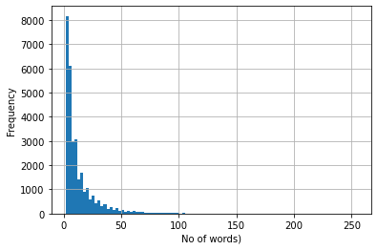
No of words vs Frequency:

Slide 7
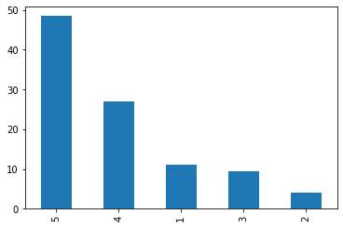
Percentage of Ratings:

Slide 8
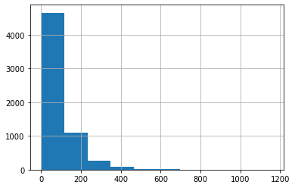
Character Length:

Slide 9
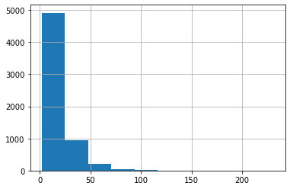
Word Length:

Slide 10
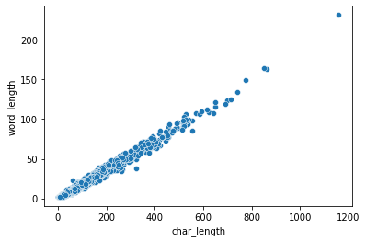
Word Length vs Character Length:

Slide 11
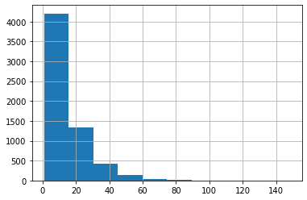
Unique Word:

Slide 12
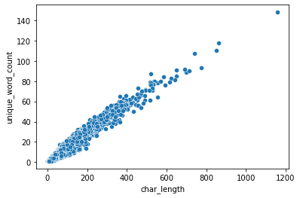
Unique Word vs Character Length:

Slide 13
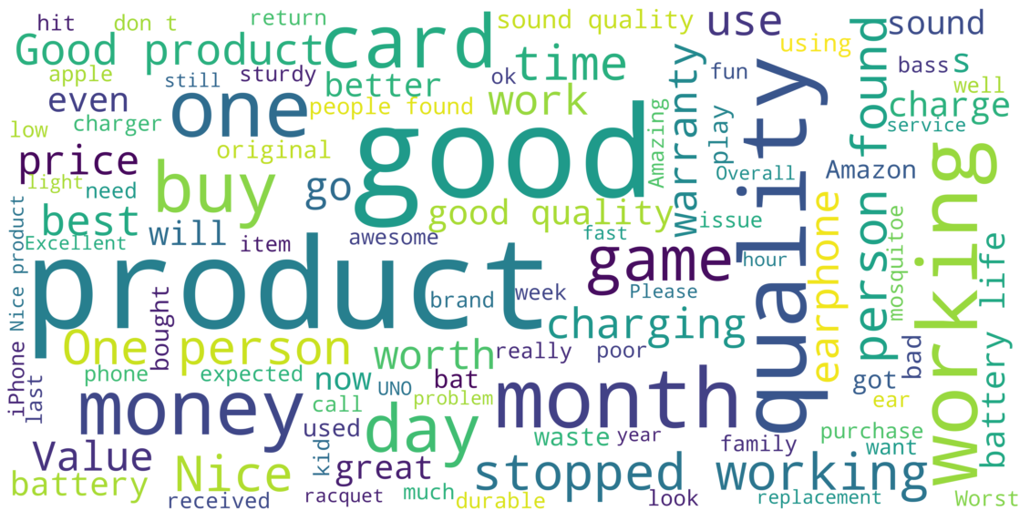
Word cloud:

Slide 14
Testing of Identified Approaches (Algorithms):
Random Forest Classifier
Linear SVC
Logistic Regression
Multinomial NB
Bernoulli NB
LGBM Classifier
SGD Classifier

Slide 15
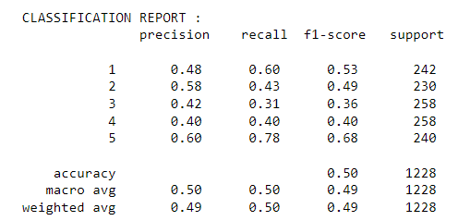
Count Vectorizer:
Accuracy Score: 49.8371335504886

Slide 16
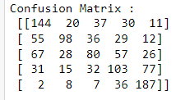
Confusion Matrix:

Slide 17
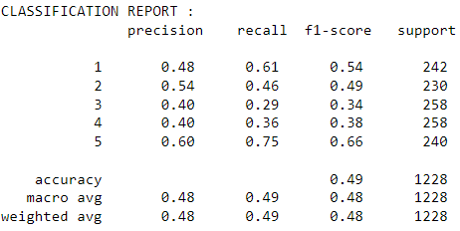
Tfidf Vectorizer:
Accuracy Score: 48.9413680781759

Slide 18
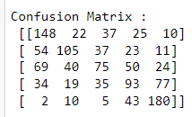
Confusion Matrix:

Slide 19
Key Findings and Conclusions of the Study:
This dataset has been taken from 2 websites of this, Flipkart and Amazon constitutes the majority of data
Since the target feature is categorical data, this problem can be solved by classification algorithms
Count Vectorizer gives an accuracy score . 49.8371335504886
TFIDF gives an accuracy score . 48.9413680781759

